Slide 1
CTS2 Introduction and Overview Introduction to the Common Terminology Services 2 Standard
Scott Bauer, Cory Endle
HL7 Working Group Meeting
January 13th -18th, 2013

Slide 2
Purpose and Outline
Provide a background to Terminology Services
Outline the process and history culminating in the completion of the specification
Describe the artifacts of this process and their purpose
Discuss the architecture of the API and how it can be implemented
Report on and demonstrate current implementations

Slide 3
Communication is about Language
Language - a “specification” that enables communication
Semantics - the association between signs or symbols and their intended “meaning”
Syntax - the rules for ordering and structuring the signs into phrases and sentences
Pragmatics - the relationship between signs and symbols and the recipient. Broadly, the shared context.

Slide 4
The Semiotic Triangle
Thought or Reference
Refers to
Symbolizes
Referent
Stands for
Symbol
C.K Ogden and I. A. Richards. The Meaning of Meaning.
Notes:
Fix footer

Slide 5
The Semiotic Triangle
Thought or Reference
Refers to
Symbolizes
Referent
Symbol
Referent
Stands for
“Rose”, “ClipArt”
C.K Ogden and I. A. Richards. The Meaning of Meaning.

Slide 6
The Communication Process
CONCEPT
CONCEPT
Refers To
Symbolizes
Symbolizes
Refers To
“I see a ClipArt image of a rose”
“Rose”,
“ClipArt”
“Rose”,
“ClipArt”
Referent
Stands For
Stands For
Symbol
Symbol

Slide 7
The Communication Process
Semantics
CONCEPT
CONCEPT
Refers To
Symbolizes
Refers To
“I see a ClipArt image of a rose”
Symbolizes
“Rose”,
“ClipArt”
“Rose”,
“ClipArt”
Referent
Stands For
Stands For
Symbol
Symbol

Slide 8
The Communication Process
Semantics
CONCEPT
CONCEPT
Refers To
Symbolizes
Symbolizes
Refers To
“I see a ClipArt image of a rose”
“Rose”,
“ClipArt”
“Rose”,
“ClipArt”
Referent
Stands For
Stands For
Symbol
Symbol
Syntax

Slide 9
The Communication Process
Semantics
CONCEPT
CONCEPT
Refers To
Symbolizes
Symbolises
Refers To
“I see a ClipArt image of a rose”
“Rose”,
“ClipArt”
“Rose”,
“ClipArt”
Referent
Stands For
Stands For
Symbol
Symbol
Context
Context
Syntax
Shared Context

Slide 10
Common Forms of Contextual Formalism
Dictionaries
Thesauri
Textbooks, college courses, etc.
Operations manuals
Data dictionaries
… Ontologies (recent)

Slide 11
AKA… Terminology
Dictionaries
Thesauri
Textbooks, college courses, etc.
Operations manuals
Data dictionaries
… Ontologies (new)

Slide 12
“Terminology”
A generic “term” that covers a broad spectrum:
Code / Value pairs – Country codes, airline codes, fare codes, ...
Controlled vocabularies – when United Airlines uses “confirmed reservation”, they mean “...”
Thesauri – if you’re are looking for information on the Tiger Swallowtail, you might also look at books with butterfly pictures, books about insect migration.

Slide 13
“Terminology” (continued)
Classifications – “buckets” for various statistical and information gathering purposes. Example: ICD-9-CM – 250.01 “Diabetes Mellitus with complication, type 1, not stated as uncontrolled”
Formal Logic Systems – Web Ontology Language (OWL), OBO, Common Logic, .... Classes, individuals relationships. SNOMED-CT, Gene Ontology, FMA, CYC, SUMO, ...

Slide 14
Why Terminology Services?
Start with a simple example – the ISO Country Codes:
Where can you download them?
What formats are they available in?
How are they organized? How do I list just EU countries? Countries in Africa?
Oh – they change???? How do I know when a change occurs? How do I know what happened?
Notes:
Transitional slide beforehand

Slide 15
Why Terminology Services?
Ok – I’ve downloaded them...
I create a set of SQL tables...
... construct some queries to create a dropdown list for a form
... write an Ajax application for my web page
... write some more queries to print the full names on a report
Notes:
Explain Ajax

Slide 16
Why Terminology Services?
Discover the accounting package needs three character codes
Ack – I repeat the download and write a conversion
Discover the accounting package hasn’t updated their tables since 1990... - what do we do with “YU”
Discover ISO reuses codes (!!!)

Slide 17
Why Terminology Services?
We’ve just been bought... our new owner doesn’t use ISO codes
... we’ve got to start translating between ISO codes and 01-299 codes
... and they’ve got “YU”...
... and they now need to know what currencies are (and were) used in a given country...

Slide 18
Why Terminology Services?
Take the scenario above and figure that a reasonably complex business such as a medical practice may have to deal with
.... hundreds of tables / classifications / relationships each with its own formats, labels, release cycles, rules
... many applications that define, create and consume these terminologies
... other businesses with the same information but different codes and formats
.... An ever increasing load of reporting / analysis / billing requirements ...

Slide 19
Why Terminology Services? Terminology Service Requirements
At some point, it begins to make sense to try to come up with:
A catalog of terminologies
Who maintains them, what they are for, how often they are updated, what they cost, ...
A simple way to download, deploy and update their content

Slide 20
Why Terminology Services? Terminology Service Requirements
A way to ask similar queries in the same way:
By textual content – “All currencies that use the ‘$’ symbol”
By organization – “All EU countries”
By relationship – “All countries that share a border with France”
By secondary set – “All countries that are HL7 members”

Slide 21
Why Terminology Services? Terminology Service Requirements
Reasoning
maps between terminologies
incremental updates
local extensions
“binding” to data elements
different output formats

Slide 22
Why Terminology Services? Summary
SOA and information exchange require shared semantics (terminology)
Shared semantics, in turn, requires shared terminology
No one can afford to do their own research, write their own importers, access methods, Ajax widgets, update mechanisms, etc.

Slide 23
Why Terminology Services? Summary
Terminology Service Standards provide:
Semantics for terminology
Shared exchange models
Complete and robust requirements
Common API’s

Slide 24
Terminology Services A Short History

Slide 25
Common Terminology Services A Short History: OMG and CTS
CTS2 Derives from:
OMG Lexical Query Service (LQS) Standard (1999)
OO Model, read only, but laid most of the foundation for subsequent efforts
HL7 CTS Specification (2004)
ANSI and ISO Standard
SOA Model, read only, reduced scope from LQS

Slide 26
Common Terminology Services A Short History: CTS
Developed to meet HL7 requirements:
LQS was deemed too big to implement
Designed to be read only
Versioning and revisions not included in the specification

Slide 27
Common Terminology Services A Short History: CTS
Formal Specification in:
UML model
OMG IDL language
This was released prior to convenient Model Driven Architecture tools
No clean way to get from UML to Java
Instead Apache Axis was used to produce a WSDL and Java Beans were derived from that WSDL

Slide 28
Common Terminology Services A Short History: CTS
The specification was designed in two distinct layers
A message API meant to be HL7 V3 specific
A vocabulary API designed to be generic
Runtime API designed for performance and production
Browser API designed for high functionality, low use
Notes:
Expand API

Slide 29
Common Terminology Services A Short History: CTS
Additional Vocabulary API’s
Vocabulary Translation Layer
Code mapping (minimal one-to-one code system level mappings)

Slide 30
Common Terminology Services 2 A Short History: CTS2
CTS2 Derives from (continued):
Mayo LexGrid information model (2002 – present)
National Cancer Institute NCI LexEVS (2005 – present)
HL7 Service Functional Model (SFM)
Work and insights of many individuals and organizations...

Slide 31
Common Terminology Services 2 Approach
Developed via the Healthcare Services Specification Program or HSSP process:
HL7 issued the starting requirements document (HL7 SFM)
Requirements transferred to Object Management Group (OMG), which issued a Request for Proposal through the Ontology Platform Committee
Participants drawn from W3C, Healthcare, XML, Space, Finance and other communities

Slide 32
Common Terminology Services 2 Approach
Developed via the HSSP process (continued)
Specification submitted to OMG and balloted June 2011. Issued as a “Beta” spec
Implementations developed, issues submitted to CTS2 Finalization Task Force
Accepted for adoption by the OMG in August 2012 – available on OMG web site

Slide 33
Healthcare Services Specification Project Approach: (HSSP) Workflow
HL7
OMG
Vendor
Community
1
SFM
SFM
2
RFP
Proposed
Standard
We Are
Here…
HL7
Implementation
Guide
3
Beta
Standard
FTF
4
4
Vocab committee
Normative
process
Corrections / Clarifications
Final
Standard
5
Notes:
Fix to make the end process normative.
----- Meeting Notes (12/27/12 14:02) -----
Out of the vocabulary working group the SFM was created by multiple contributers. This ducument captured the functionality required by a terminology service.
Published as a Draft Standard for Trial Use. Handed over to the OMG, and an RFP was issued for the community to respond with the intent of having a implementation and PIM and PSM created. There were multiple reponsders, and they were required to harmonise their response. That response included a PSM and a PIM, one for soap and one for REST.(3). At that point the proposal was accepted by OMG and a beta standard was made available for review. The beta was available for one year and during that time a task force was put into place and the finalization task force addressed any community issues or concerns. At the completion of the FTF the final standard was submitted to the OMG and approved as the standard. As part of that submission the responder to the RFP had to deliver a letter of intent stating they would deliver an implementation validating the standard. Because the original SFM was a draft standard which expired, the final OMG standard is in the normative process which will release an official standard. The implementation guide will be completed after the standard is normative.

Slide 34
CTS2 Service Functional Model (SFM) Approach: SFM
SFM insured that the implementation was complete
Describes use cases and functionality for the specification
The SFM is not normative

Slide 35
CTS2 Service Functional Model (SFM) Approach: SFM
Balloted as a draft standard for trial use (DSTU)
Turned over to OMG where it was used to create a Platform Independent Model or PIM and a Platform Specific Model or PSM.
Now moving toward a normative specification

Slide 36
CTS2 PIM, Platform Independent Model Approach: The role of the PIM
A Unified Modeling Language (UML) representation:
Defines names, purpose and how used.
No physical rendering (i.e. Java Beans, C++ classes, XML schema, etc.)
The PIM can be transformed into multiple Platform Specific Models

Slide 37
CTS2 PIM, Platform Independent Model Approach: The role of the PIM
Comprised of an:
Information Model
Computational Model

Slide 38
CTS2 PSM: Platform Specific Model Approach: The Role of the PSM
CTS2 representations in
XML schema, allowing content to be created in XML (A PSM of the Information Model)
WADL: a REST interface to the the computational and information model
WSDL: a SOAP interface to the same computational and information model
Notes:
We’ve described the artifacts of this process and in sum they comprise CTS2

Slide 39
CTS2 Specification
A model and specification for discovering, accessing, distributing and updating terminological resources on the internet.

Slide 40
CTS2 Specification
The CTS2 specification provides:
A model and set of symbols for discussing terminology:
Formal in UML / Z
Practical in XML Schema
A RESTful Architecture for querying, exchanging and updating terminological content
Notes:
REST also supports the modular structure of the architecture. One of the original responses was in Zed which was harmonized with the UML

Slide 41
CTS2 Specification Resource-Oriented Architecture
It's just four concepts:
Resources
Their names (URIs)
Their representations
The links between them
And four properties:
Addressability
Statelessness
Connectedness
A “uniform interface”
RESTFul Web Services – Richardson and Ruby, 2007

Slide 42
CTS2 Specification Why REST?
Enables “Linear Value Proposition”
Easy things should be easy
Cost of adding complexity should be linear
Proven Technology
Architecture of the World Wide Web
Can leverage existing WWW tools (HTTP / XML / XSLT / …)
Enables modular architecture
Notes:
Fix footer

Slide 43
CTS2 Specification API
CTS2 is an Application Programming Interface (API) specification.
It defines the semantics, syntax and valid interactions that can occur
It is a “blueprint” for software
If everyone follows the blueprint (and the blueprint is sufficiently precise) then CTS2 clients and services can interoperate
Notes:
footer

Slide 44

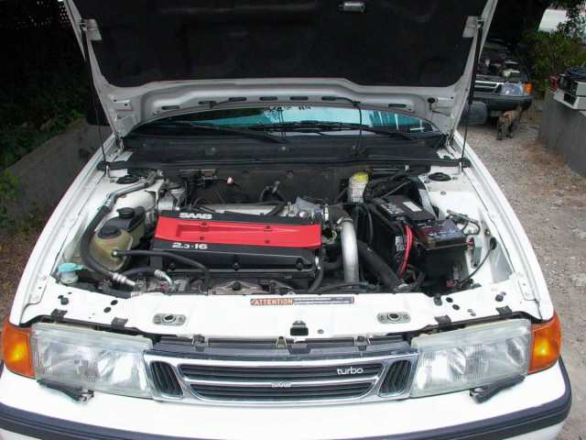

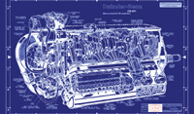


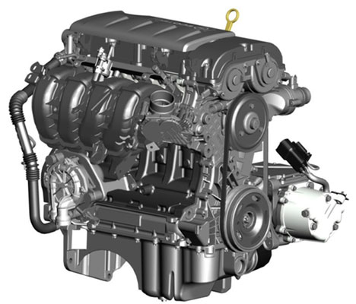
CTS2 Standard as a Blueprint
CTS2 Clients
CTS2 Services
Notes:
An analogy might be a blueprint for an engine - a detailed specification of the various parts that go into engine assembly as well as the dimensions, requirements, etc. that would allow the engine to be used in a motor vehicle. This blueprint would allow engine manufacturers (terminology service providers) to assemble some or all of the components of the engine in a way that would allow them to be assembled into a variety of working models. At the same time, vehicle manufacturers (client software developers) could configure their components in a way that would allow engines from different manufacturers to be used in the same vehicle.

Slide 45
Modular Specification Implement / use what you need
Code System Catalog Entry and Code System Version Catalog Entry
Entity Description and Association
Value Sets, Value Set Definition and Resolved Value Set
Map, Map Version
Concept Domain and Concept Domain Binding
Statement Model

Slide 46
Modular Functionality Implement / use what you need
Read
Query
Import
Export
Update
Maintenance
History
Temporal

Slide 47
Each Module Has
Formal Information Model in UML
Defines the resource, how it is identified and what information it contains
Formal Computational Model in UML
Defines operations that are available for each functional (read, query, import, …) profile

Slide 48
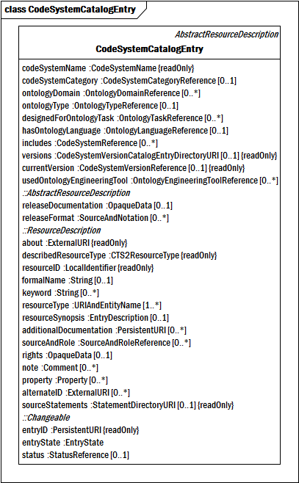
Formal
Information
UML

Slide 49
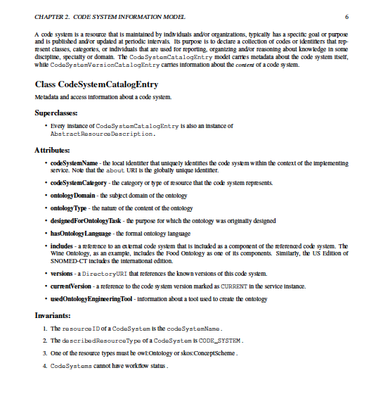
Formal
Information
UML

Slide 50
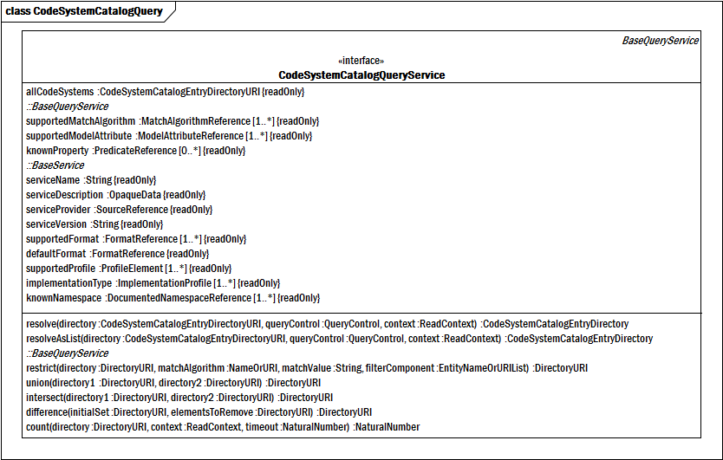
Formal Computational Model

Slide 51
Each Module Also Has
XML Schema representation of the Information Model
WADL rendering of Computational Profiles
Defines the URLs + operations (GET, PUT, POST, REMOVE) that implement the computations

Slide 52
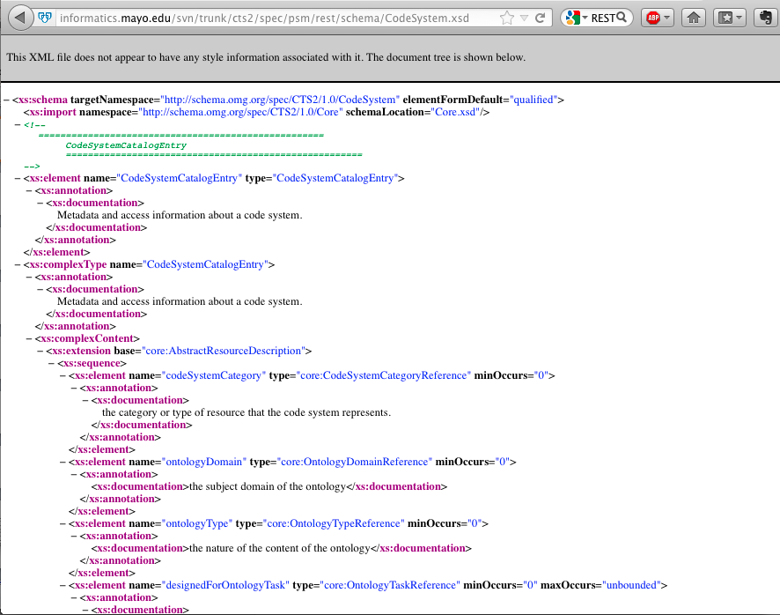
XML Schema Sample

Slide 53
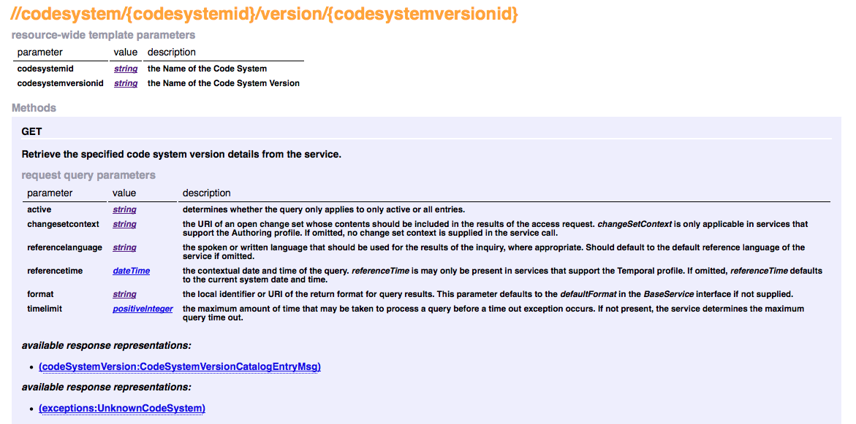
WADL Sample http://informatics.mayo.edu/svn/trunk/cts2/spec/psm/rest/html/cts2.html
Notes:
Fix footer

Slide 54
Each Module Has
WSDL Rendering of Computational model
Allows SOAP (RPC) access
JSON rendering of Information Model
Not “formal” standard
Enables Ajax (browser as a service client)

Slide 55
Combined they provide a set of rules that:
Describes (some of) what can be said about various aspects of terminologies
Provides a straight-forward format for structuring the information
Provides rules for publishing, querying, exchanging and updating information in a distributed, federated environment
Notes:
Fix footer

Slide 56
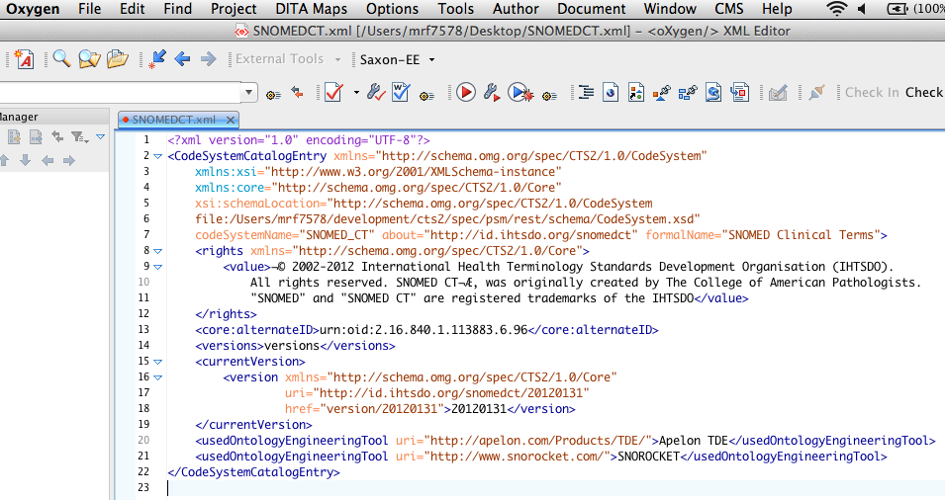
Content Can be Created with Any XML Compliant tool
Notes:
footer

Slide 57
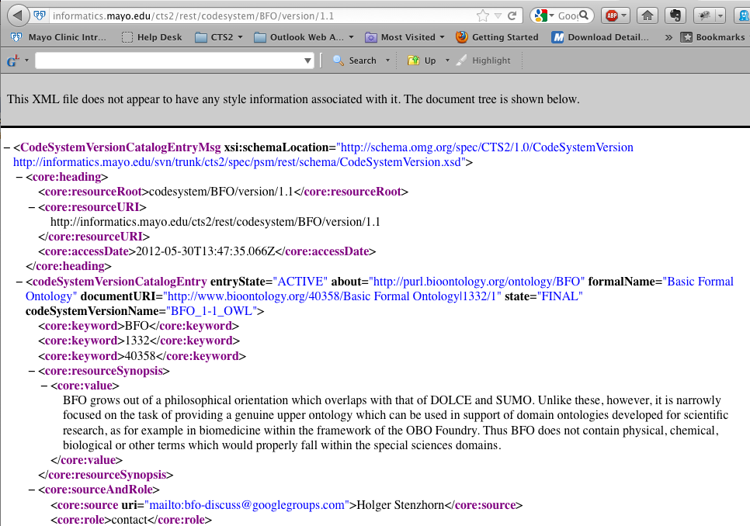
And published as http… http://informatics.mayo.edu/cts2/rest/codesystem/BFO/version/1.1

Slide 58
… Or …
Web Services / SOAP Publish Discover…
JAVA Objects
JSON and other (standardization still underway)

Slide 59
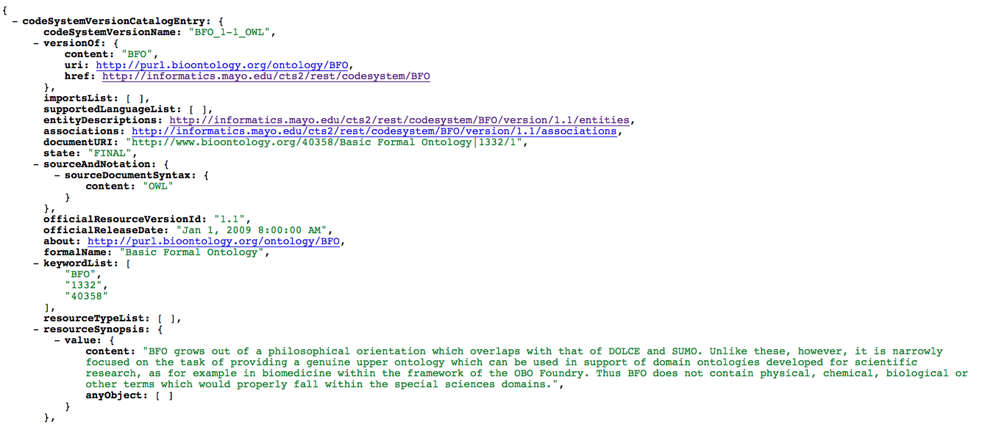
JSON

Slide 60
CTS2
The CTS2 standard is actually a collection of relatively small standards…
… and a set of assembly rules.
The goal of the CTS2 standard is distribution and federation:
Distribution means that different organizations can publish different aspects
Federation means that organizations can share
Key is that implementations can be shared…
… no one has to do it all!

Slide 61
CTS2 Design Philosophy
Simple things should be simple
Representational State Transfer Architectural Style but will support SOA(p)
Modular components allow implementation of a subset of a larger specification (Component Resources)

Slide 62
CTS2 Component Resources
Code System Catalog
Code System Version Catalog
Entity Description
Association
Map Catalog
Map Version
Concept Domain Catalog
Concept Domain Binding
Value Set Catalog
Value Set Definition
Resolved Value Set
Notes:
Code System Catalog – metadata about code systems (ontologies, code sets, thesauri, classification systems, etc.). A service would implement this section to publish information about what sort of terminological resources are available, who maintains them, what they are intended to be used for, how often they are released, what copyrights pertain to them, etc.
Code System Version Catalog – metadata about specific versions of code systems. A service would implement this section to provide information about specific versions of code systems – when they were released, what format they are in, when they were intended to become active, which version they replace, etc.
Entity Description – a set of entity (aka. “class”, “category”, “concept”, “predicate”, “property”, “term”, “individual”) identifiers known to the service along with information about which code system versions make assertions about these identifiers and what they say. The entity description service focuses on the lexical aspect of entity identifiers – providing access to the designations, definitions, descriptions, examples, usage notes and other artifacts used to represent the meaning of the entity to human consumers. Services would implement this section to publish information about the codes described in various versions of code systems along with their intended meanings.
Association – sets of “semantic” assertions about entity identifiers, in which the entity identifier may play the role of subject, predicate (verb) or object in the assertions. This area represents the formal machine interpretable aspects of code systems, and a service would implement this section to support classification, reasoning or other computational logic systems built on terminological content.
Value Set Catalog – metadata about sets of entity identifiers (value sets) that have been grouped for some purpose. A service would implement this section if it wanted to publish information about these collections such as who created them, who maintains them, what is their purpose, what code systems do they depend on, how they are updated, etc.
Value Set Definition - information about how value sets are constructed. A value set definition can be a simple enumeration of its elements or can contain instructions about how the elements are assembled from aspects of entity descriptions and associations. Value set definitions may be coupled to specific versions of code system, or may be defined in a way that they could be applied to different versions, potentially with different results. Services would implement this section to publish the rules on the construction of value sets. The value set definition section includes an optional sub- section (Resolved Value Set) that enables the publication, loading and use of the results of applying value set definitions. Services would implement this section when they needed to consume and use value sets without having access to the underlying code systems.
Concept Domain Binding – the coupling of a concept domain with a value set, where the value set provides a list of possible meanings that can be used in a concept domain in a particular use case or context.
Map Catalog – a catalog of “maps” - collection of rules that allow human or machine assisted transformation between the codes in one value set or code system and those in a second. A service would implement this section to publish information about which rule sets are available, which code systems or value sets they map between, their intended purpose, how often they are published, what formats they are in, etc.
Map Version – an instance of a map, including the specific value set definitions that and code systems that they are based on and the actual rules. A service would implement this section if it wished to publish the content of maps. This section includes an optional sub-section (Map Resolution) that provides access to the machine aided interpretation of map versions – a service that does the actual map transformation.
Statement - a bridge between the information contained in the various sections described above and the actual assertions made by the information providers. A service would implement this section when it needed to provide additional provenance about assertions made in catalogs or resource versions including what was actually said, how it mapped to the CTS2 service representation, the provenance of the assertion, etc. Statement is also intended to act as a bridge between the structured CTS2 model and simple subject/predicate/target systems as represented by OWL and RDF.

Slide 63
CTS2 Component Resources
Code System Catalog Module

Slide 64
CTS2 Component Resources Code System Catalog Module
Metadata about code systems (ontologies, code sets, thesauri, classification systems, etc.)
A service would implement this section to publish information about:
What sort of terminological resources are available,
Who maintains them, what they are intended to be used for
How often they are released,
What copyrights pertain to them, etc.

Slide 65
CTS2 Component Resources
Code System Version Catalog Module

Slide 66
CTS2 Component Resources Code System Version Catalog Module
Metadata about specific versions of code systems.
A service would implement this section to provide information about specific versions of code systems:
When they were released
What format they are in
When they were intended to become active
Which version they replace

Slide 67
CTS2 Component Resources
Entity Description Module

Slide 68
CTS2 Component Resources Entity Description Module
A set of entity identifiers known to the service
These might also be thought of as:
Class
Category
Concept
Predicate
Property
Term
Individual

Slide 69
CTS2 Component Resources Entity Description Module
Code system version information:
Which code system versions make assertions about these identifiers
What the codes systems say about them
Their intended meanings

Slide 70
CTS2 Component Resources Entity Description Module
The entity description service focuses on the lexical aspect of entity identifiers:
Providing access to:
Designations
Definitions
Descriptions
Examples
Usage notes and other artifacts used to represent the meaning of the entity to human consumers

Slide 71
CTS2 Component Resources Entity Description Module
Why would services implement this module?
To publish information about the codes described in various versions of code systems

Slide 72
CTS2 Component Resources
Association Module

Slide 73
CTS2 Component Resources Association Module
Sets of “semantic” assertions about entity identifiers
The entity identifier may play the role of
Subject,
Predicate (verb) or
Object
… in the assertions

Slide 74
CTS2 Component Resources Association Module
This area represents the formal machine interpretable aspects of code systems
A service would implement this section to support:
Classification
Reasoning
Computational logic systems built on terminological content

Slide 75
CTS2 Component Resources
Value Set Catalog Module

Slide 76
CTS2 Component Resources Value Set Catalog Module
Metadata about sets of entity identifiers (value sets) that have been grouped for some purpose
A service would implement this section if it wanted to publish information about these collections such as:
Who created them
Who maintains them
What is their purpose
What code systems do they depend on
How they are updated, etc.

Slide 77
CTS2 Component Resources
Value Set Definition Module

Slide 78
CTS2 Component Resources Value Set Definition Module
Information about how value sets are constructed.
A value set definition can:
Be a simple enumeration of its elements
Or can contain instructions about how the elements are assembled from aspects of entity descriptions and associations.

Slide 79
CTS2 Component Resources Value Set Definition Module
Value set definitions may be coupled to specific versions of code system,
May be defined in a way that they could be applied to different versions, potentially with different results.

Slide 80
CTS2 Component Resources Value Set Definition Module
Services would implement this section to:
Publish the rules on the construction of value sets.
The value set definition section includes an optional sub- section (Resolved Value Set) that enables:
Publication
Loading
Use of the results of applying value set definitions

Slide 81
CTS2 Component Resources Value Set Definition Module
Services would implement the Resolved Value Set section when they needed to consume and use value sets without having access to the underlying code systems.
Notes:
Resolution module?

Slide 82
CTS2 Component Resources
Concept Domain Catalog Module

Slide 83
CTS2 Component Resources Concept Domain Catalog Module
A catalog of abstract “concept domains” that represent a collection of possible meanings
Concept domains are intended to represent the intended meaning of a field on:
Form
Column in a database
Field in a message, etc.

Slide 84
CTS2 Component Resources Concept Domain Catalog Module
The CTS2 specification focuses on enumerated concept domains :
Fields that represent discrete collections of “meanings”
Each of which is represented by a permissible value

Slide 85
CTS2 Component Resources Concept Domain Catalog Module
A service would implement this module to provide a list of generic fields that would be used in data interchange.

Slide 86
CTS2 Component Resources
Concept Domain Binding Module

Slide 87
CTS2 Component Resources Concept Domain Binding Module
The coupling of a concept domain with a value set, where the value set provides a list of possible meanings that can be used in a concept domain in a particular use case or context.

Slide 88
CTS2 Component Resources
Map Catalog Module

Slide 89
CTS2 Component Resources Map Catalog Module
A catalog of “maps” - collection of rules that allow human or machine assisted transformation between the codes in one value set or code system and those in a second.

Slide 90
CTS2 Component Resources Map Catalog Module
A service would implement this section to publish information about
Which rule sets are available
Which code systems or value sets they map between
Their intended purpose
How often they are published
What formats they are in, etc.

Slide 91
CTS2 Component Resources
Map Version Module

Slide 92
CTS2 Component Resources Map Version Module
An instance of a map, including the
Specific value set definitions
Code systems that they are based on and the actual rules
This module includes an optional sub-section (Map Resolution) that provides access to the machine aided interpretation of map versions – a service that does the actual map transformation

Slide 93
CTS2 Component Resources Map Version Module
A service would implement this section if it wished to publish the content of maps.

Slide 94
CTS2 Component Resources
Statement Module

Slide 95
CTS2 Component Resources Statement Module
A bridge between the information contained in the various sections described above and the actual assertions made by the information providers
Statement is also intended to act as a bridge between the structured CTS2 model and simple subject/predicate/target systems as represented by OWL and RDF
Contains direct support for bnode and reification

Slide 96
CTS2 Component Resources Statement Module
A service would implement this section when it needed to provide additional provenance about assertions made in:
Catalogs or resource versions including what was actually said
How it mapped to the CTS2 service representation
The provenance of the assertion, etc.

Slide 97
CTS2 Functional Profiles Computational Model for each Module
Read
Query
Import
Export
Update
History
Maintenance
Temporal
(specialized)
Notes:
Read – direct access to the contents of a resource via URI, local identifier or, where applicable, a combination of an abstract resource identifier and version tag (e.g. SNOMED-CT / Current version)
Query – the ability to access, combine and filter lists of resources based on the resource content and user context Import and Export – the ability to import external content into the service and/or export the contents of the service in different formats
Update – the ability to validate load sets of changes into the service that updates its content
History – the ability to determine what changes have occurred over stated periods of time
Maintenance – the ability to create and commit sets of changes
Temporal – the ability to ask questions about the state of the service at a given point in the past (or future).
Specialized – service specific functions such as the association reasoning services, the map entry services and the resolved value set services.
The Import, Export and Temporal functions are generic – there are no resource specific aspects to these services and, as such, they are defined once in the Core Service Elements module. The remaining components have different signatures depending on the structural domain to which they are applied.

Slide 98
CTS2 Functional Profiles
Read Function

Slide 99
CTS2 Module Functions Read Function
Direct access to the contents of a resource via:
URI
Local identifier
Where applicable, a combination of an abstract resource identifier and version tag (e.g. SNOMED-CT / Current version)

Slide 100
CTS2 Functional Profiles
Query Function

Slide 101
CTS2 Module Functions Query Function
The ability to access, combine and filter lists of resources based on the resource content and user context

Slide 102
CTS2 Module Functions Import and Export

Slide 103
CTS2 Module Functions Import and Export Functions
The ability to import external content into the service and/or export the contents of the service in different formats.
Notes:
Import and Export – the ability to import external content into the service and/or export the contents of the service in different formats

Slide 104
CTS2 Functional Profiles
Update Functions

Slide 105
CTS2 Module Functions Update Functions
The ability to validate load sets of changes into the service that updates its content.

Slide 106
CTS2 Functional Profiles
History Function

Slide 107
CTS2 Module Functions History Function
The ability to determine what changes have occurred over stated periods of time.

Slide 108
CTS2 Functional Profiles
Maintenance Function

Slide 109
CTS2 Module Functions Maintenance Function
The ability to create and commit sets of changes

Slide 110
CTS2 Functional Profiles
Temporal Function

Slide 111
CTS2 Module Functions Temporal Function
The ability to ask questions about the state of the service at a given point in the past (or future).

Slide 112
CTS2 Functional Profiles
Specialized Function

Slide 113
CTS2 Module Functions Specialized Function
Service specific functions such as:
the association reasoning services
the map entry services
the resolved value set services
Functions that don’t fall into the categories of other functions

Slide 114
CTS2 Module Functions
The Import, Export and Temporal functions are generic
There are no resource specific aspects to these services and, as such, they are defined once in the Core Service Elements module
The remaining components have different signatures depending on the structural domain to which they are applied

Slide 115
CTS2 Module and Functions Summary
At this point you should:
Have enough information to determine what modules you should might want to implement or consume
Have some idea what functions you would like to use to consume content
Next let’s examine how a project leader might coordinate such an implementation

Slide 116
CTS2 Implementation Project and Resource Planning
High level decisions need to be made about:
Whether you want to create a service
Consume services
Or both
Notes:
Transition slide before this

Slide 117
CTS2 Implementation Project and Resource Planning
High level decisions continued:
If creating a service:
Which modules do you want to implement
Which module functions do you want to implement.

Slide 118
CTS2 Implementation Project and Resource Planning
Service creation requires:
Ontology and CTS2 expertise to create a map from source to CTS2 model elements
Development staff with experience in Spring, REST and Java
Server and system administration resources

Slide 119
CTS2 Implementation Project and Resource Planning
Service consumption:
Identify relevant terminology sources
Establish the range of services implemented at each service
Satisfy licensing and authentication issues for any restricted sources

Slide 120
CTS2 Implementation Project and Resource Planning
Service consumption requires:
Development staff with experience in REST, SOAP (limited), JSON or XML
Implementation of some kind of http or https connection and parsers for JSON, XML or SOAP messaging

Slide 121
CTS2 Implementation Project and Resource Planning
Service consumption:
Development opportunities:
Examples available for JavaScript, Java, Scala, and Python
Platform and implementation strategies:
Scope of the implementation
Capability of the platform to connect to REST service
Consume XML, SOAP, JSON

Slide 122
CTS2 Implementation Project and Resource Planning
At this point you should be able to:
Make a decision as to whether you want to provide a service or a client
Understand what resources are required
Have a sense of which modules and which module functions you want to implement

Slide 123
CTS2 Summary
We’ve had an introduction to the purpose and scope of CTS2
Described its history and provenance
Discussed its technical representations as both Platform Independent Model and Platform Specific Model
Given an overview of all specification modules and their functions
We’ll now proceed to discuss and demonstrate current CTS2 Implementations

Slide 124
CTS2 Development Framework and Implementations
Cory Endle

Slide 125
Outline
CTS2 Development Framework Overview
CTS2 Development Framework Implementations
eXist DB
MU Quality Measure Value Set Service
NCBO BioPortal REST
NCBO BioPortal RDF

Slide 126
Outline(continued)
CTS2 Implementation (not created with the Development Framework)
SNOMED CT RF2 (py4cts2)
GUI Implementations
CTS2 Value Set Viewer
High-Throughput Phenotyping (HTP)
UI Widgets

Slide 127
CTS2 Development Framework Overview

Slide 128
CTS2 Development Framework Overview
A framework or development kit for rapidly creating CTS2 compliant applications
Allows users to create plugins which may be loaded into the Development Framework to provide REST services that use CTS2 compliant paths and model objects

Slide 129
CTS2 Development Framework Overview
Developers are required only to implement the functionality that is exclusive to their environment.
This code may retrieve data from a database, read data from a file system, aggregate two more other services
Notes:
The Development Framework provides all of this infrastructure - handles HTTP requests, errors, logging, etc.
Functionality to resolve a value set or read a code system

Slide 130
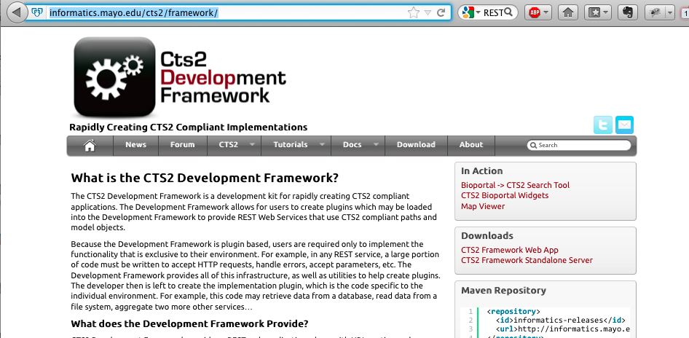
CTS2 Development Framework Overview
CTS2 Development Framework
http://informatics.mayo.edu/cts2/framework/
Notes:
All open source
Samples, downloadable code, tutorials, documentation

Slide 131
CTS2 Implementations

Slide 132
CTS2 Development Framework Implementations eXist DB
eXist XML Database Plugin:
A CTS2 implementation based on the eXist Database (an Open Source Native XML Database).
Supports:
READ
QUERY
MAINTENANCE
Notes:
Started out as a prototype and turned One of first and Mostly fully featured implementation
Cts2 functional profiles (only one to support Maintenance)

Slide 133
CTS2 Development Framework Implementations MU Quality Measure Value Set Service
A CTS2 Query implementation of Value Sets based on Meaningful Use 2 Standards for NQF eMeasures
Value Sets provided by US National Library of Medicine (NLM)
Supports:
READ
QUERY
Notes:
The NLM is the Value Set Authority repository for all meaningful use eMeasures.
eMeasures are
An eMeasure (patients with diabetes or patients with hypertension) contains one or more VS containing concepts. These concepts identify the eMeasure.
We are currently mirroring the NLM VS using our eXist implementation --- and we are working on a new plugin to wrap their REST interfaces.

Slide 134
CTS2 Development Framework Implementations NCBO BioPortal
Component of the National Center for Biomedical Ontologies (NCBO)
Mission:
Create software and support services for the application of principled ontologies in biomedical science and clinical care, ranging from tools for application developers to software for end-users.
Notes:
Repository for ontologies,
Host ontologies. Provide tools to access the content

Slide 135

CTS2 Development Framework Implementations NCBO BioPortal
Web-based application for accessing and sharing biomedical ontologies
Search for terms
Submit a new ontology to BioPortal library
Views on large ontologies
Explore mappings between ontologies
REST based API
Many useful viewing, browsing and access widgets

Slide 136
CTS2 Development Framework Implementations NCBO BioPortal REST
NCBO BioPortal Wrapper
A CTS2 Implementation based on the NCBO BioPortal REST service
Supports:
READ
QUERY
http://informatics.mayo.edu/cts2/rest/valuesets
Notes:
Based on our experience with the eXist DB plugin, this was our next implementation into an existing datasource
Entity, codesystem, codesystem version, value sets

Slide 137
CTS2 Framework Implementations NCBO BioPortal RDF
RDF Triplestore Wrapper
A CTS2 implementation based on the NCBO BioPortal SPARQL endpoint
Supports:
READ
QUERY
http://informatics.mayo.edu/cts2/services/bioportal-rdf/valuesets
Notes:
NCBOs most recent implementation is RDF
Resource Description Framework (RDF)

Slide 138
CTS2 Implementations
SNOMED CT RF2 (py4cts2)
A Python implementation of CTS2 to expose the the contents of the SNOMED CT RF2 distribution
This service provides REST based access to the SNOMED CT RF2 tables and their equivalent CTS2 rendering.
Supports READ and QUERY
Notes:
Implementation not using the CTS2 Framework
Did this to validate CTS2 could be implemented without the framework.

Slide 139
CTS2 Client (using py4cts2)
Examples
CTS2 Viewer – Entity Details Window
https://informatics.mayo.edu/vsmc/
http://informatics.mayo.edu/cts2/services/py4cts2/cts2
Notes:
Show CTS2 Viewer Entities window and
http://informatics.mayo.edu/cts2/services/py4cts2/cts2/

Slide 140
Web Applications using the CTS2 Service

Slide 141
Web Applications CTS2 Value Set Viewer
Generic Value Set Browser/export
Initially created for Meaningful Use (MU) Quality Measure Value Set Service to serve NLM Value Sets.
Can view any CTS2 compliant Value Set service (NCBO,PHINVADS CDC,VSAC)
https://informatics.mayo.edu/vsmc

Slide 142
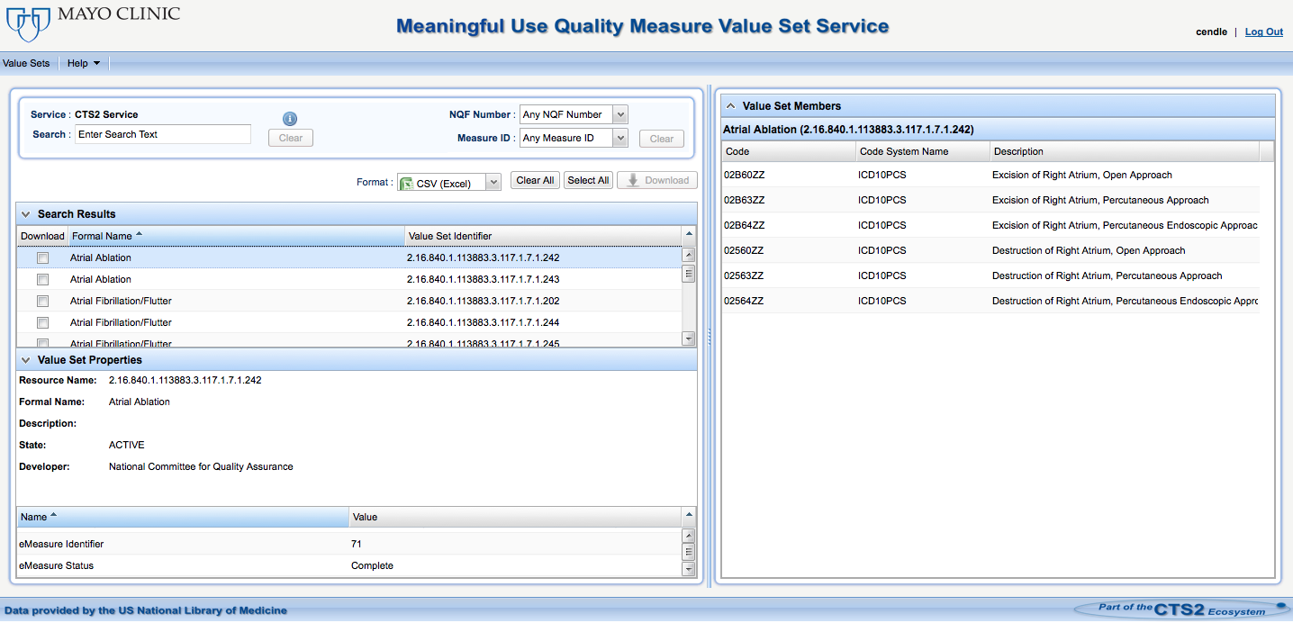
Web Applications CTS2 Value Set Viewer

Slide 143
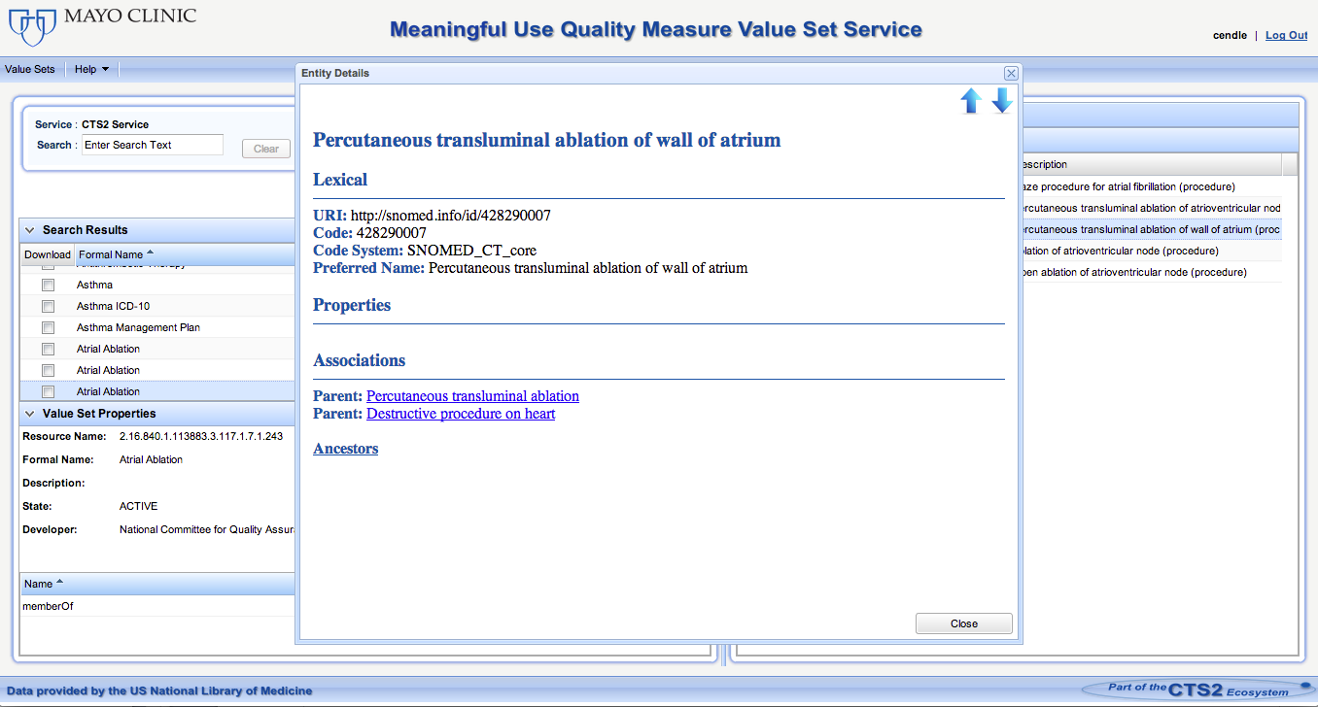
Web Applications CTS2 Value Set Viewer
Using py4cts2 implementation to retrieve entities and their associations

Slide 144
Web Applications High-Throughput Phenotyping (HTP)
A tool to help identify patient cohorts using electronic health record (EHR) data by leveraging informatics-based phenotyping processes
Rules from the National Quality Forum (NQF) Quality Data Model (QDM) files can be uploaded to the Phenotype Portal
Notes:
We using the MU eMeasure applying against patient data to find coharts.

Slide 145
Web Applications High-Throughput Phenotyping (HTP)
Convert structured phenotype criteria into executable queries using JBoss Drools Rules
Runs against Clinical Element Model (CEM) DB and EHRs to find cohorts that match the given criteria

Slide 146
Web Applications High-Throughput Phenotyping (HTP)
Users can currently view Value Sets and their entities via the CTS2 service
Planned availability to add/remove entries from Value Sets and save them. This will allow the user to execute the phenotypes with modified criteria to see how it affects the results
Notes:
Describe the overall process of the the algorithm execution and the results.

Slide 147
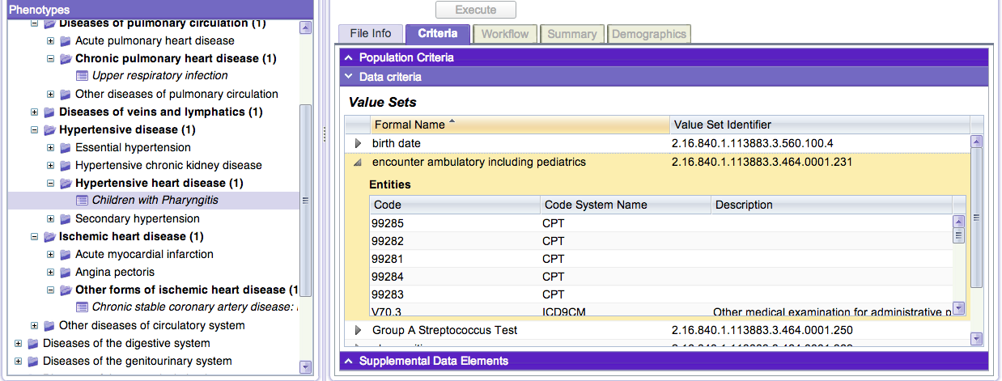
Web Applications High-Throughput Phenotyping (HTP)
http://phenotypeportal.org/

Slide 148
CTS2 Enabled UI Widgets

Slide 149
CTS2 Enabled UI Widgets Overview
Tooltips
jQuery tooltip widget used to display Value Sets and Code Systems when you mouse over text
Autocomplete
jQuery autocomplete widget used to suggest Value Sets as you type

Slide 150
UI Widgets Overview
Dropdown
jQuery example to fill a select (dropdown) with specific resolved Value Sets

Slide 151
CTS2 Enabled UI Widgets Demonstration
http://informatics.mayo.edu/cts2widgets/widgets.html
Features and customization points of each widget.
Ability to set the Value Set ID/Code System ID to retrieve different values
Cascading Style Sheets (CSS) to change the look and feel
CTS2 parameterized values to customize the query
Notes:
Go to http://informatics.mayo.edu/cts2widgets/widgets.html

Slide 152
References
CTS
http://informatics.mayo.edu/LexGrid/downloads/CTS/specification/ctsspec/cts.htm
LexEVS
https://cabig-kc.nci.nih.gov/Vocab/KC/index.php/LexEVS
BioPortal
http://bioportal.bioontology.org/
BioPortal REST Services
http://www.bioontology.org/wiki/index.php/BioPortal_REST_services
CTS2
http://informatics.mayo.edu/cts2

Slide 153
References
CTS2 Development Framework
http://informatics.mayo.edu/cts2/framework/
Healthcare Services Specification Program
http://hssp.wikispaces.com/
BioPortal REST Wrapper
http://informatics.mayo.edu/cts2/rest/valuesets
BioPortal RDF Wrapper
http://informatics.mayo.edu/cts2/services/bioportal-rdf/valuesets
BioPortal SPARQL endpoint:
http://sparql.bioontology.org/

Slide 154
References
MU Quality Measure Value Set Service
https://informatics.mayo.edu/cts2/services/mat/valuesets
GUIs that display CTS2 Content:
https://informatics.mayo.edu/vsmc/?showAll=true
http://www.phenotypeportal.org/
UI Widgets Example:
http://informatics.mayo.edu/cts2widgets/widgets.html
UI Widgets in GitHub:
https://github.com/cts2/
https://github.com/cts2/cts2autocomplete
https://github.com/cts2/cts2tooltip
https://github.com/cts2/cts2dropdown

Slide 155
Questions & Discussion

